Slide 1
TUM-RIKEN collaborative research: January 26th , 2022
NeRmo project: Analysis on spinal motions of mice
Satoshi Oota

Slide 2
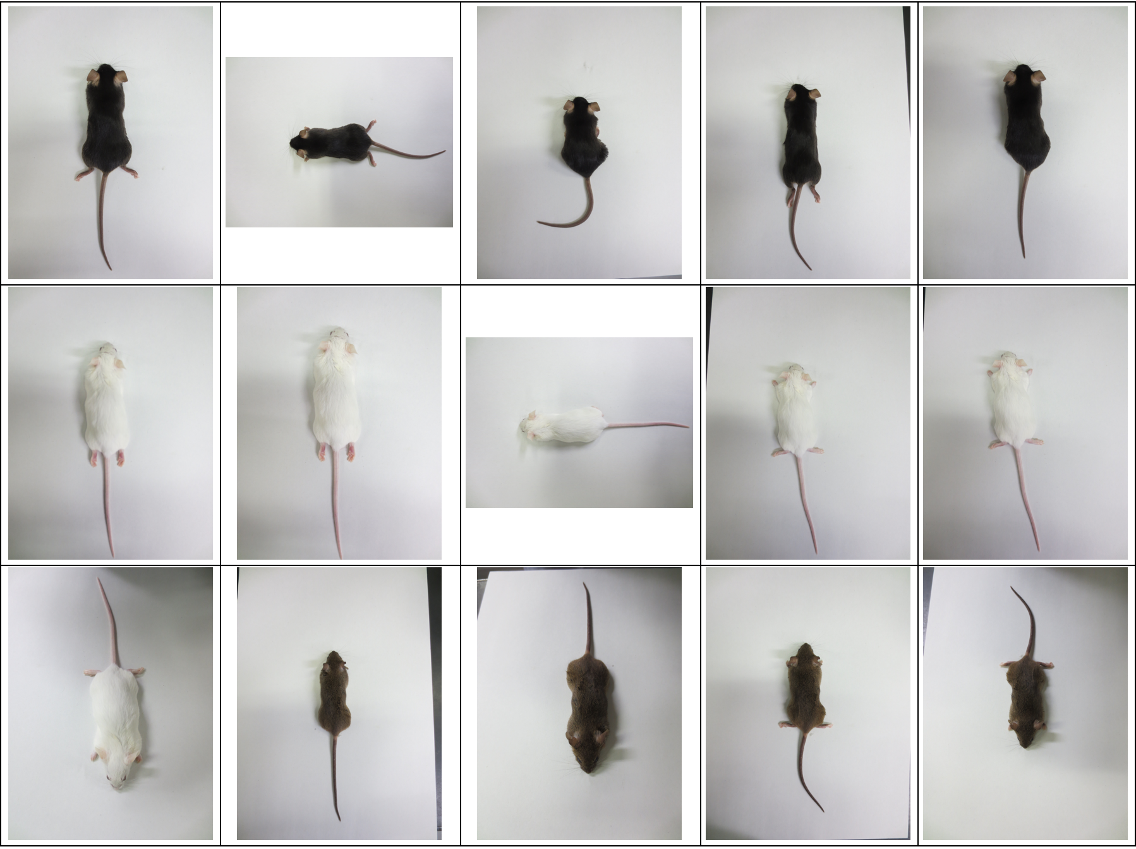
Available mice

Slide 3
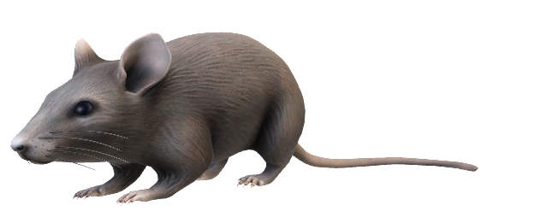
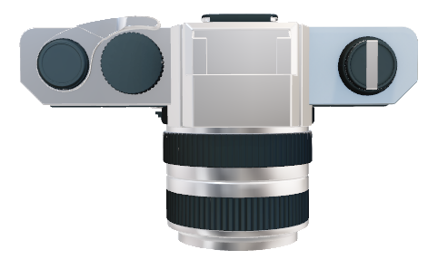
Camera setup (RIKEN BRC, Tsukuba)
Canon EOS80D
EF-S18-55mm
30 fps
Mouse
A water tank lined by green sheets

Slide 4
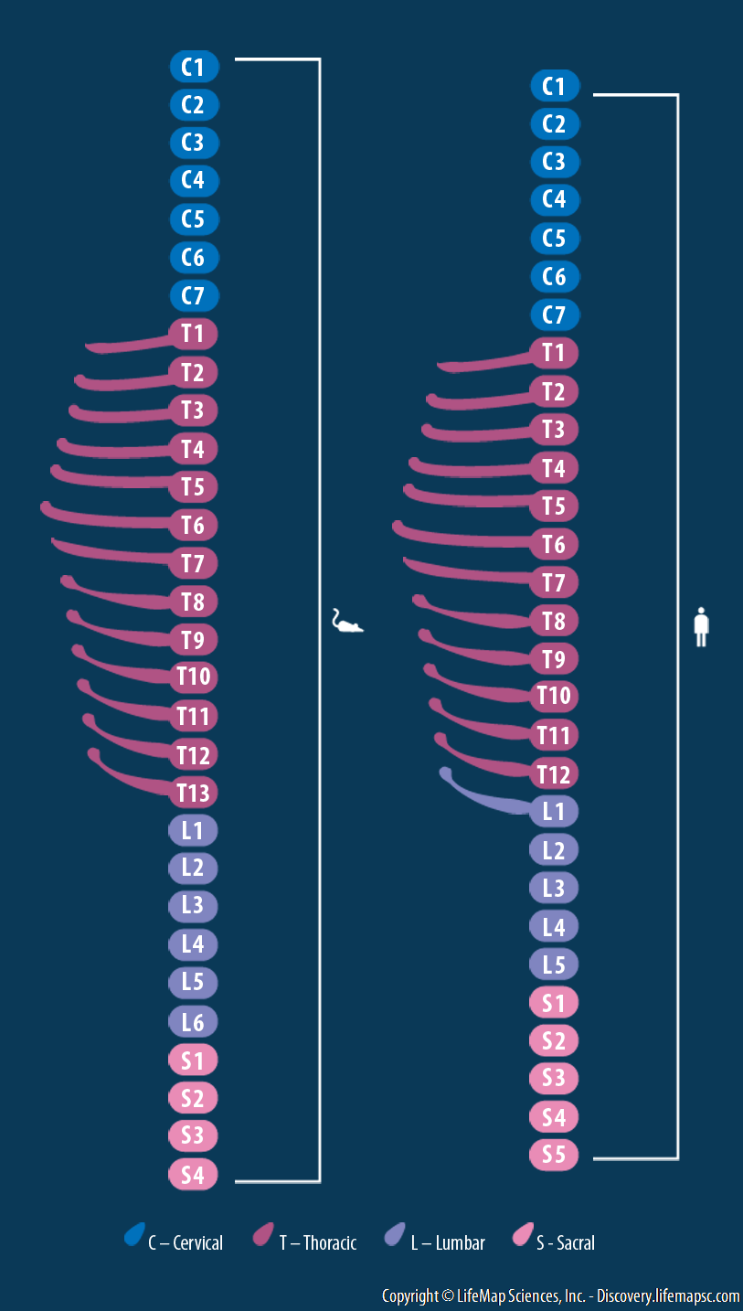
Marker labeling (15 markers)
Over scapelas/Back 2
L6/Back 5
Head
T13/Back 3
Back 4
S4/ Back 7
Back 1
Back 6
Back 8
T1/Back 9
T2/Back 10
Back 11
T3/Back 12
Back 13
T4/Back 14
Equally spaced labels along tail length

Slide 5
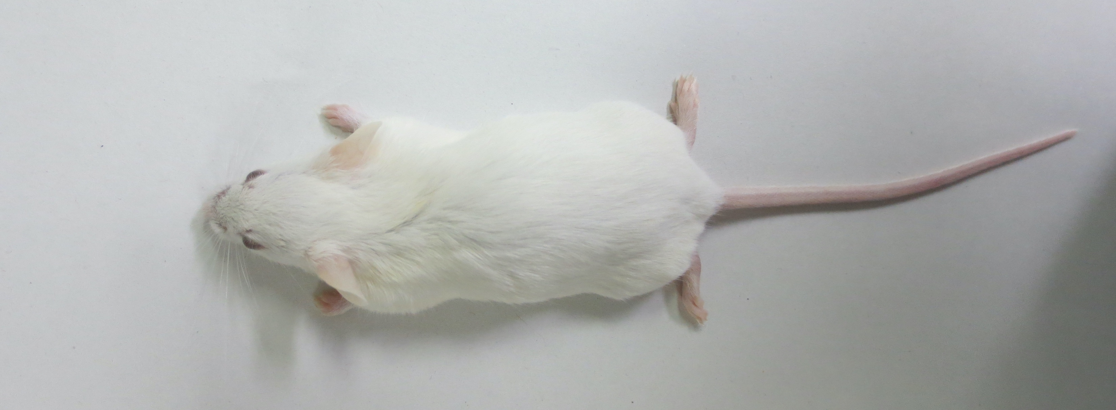
Labeling for accurate tracking
Back 12
Back 11
Back 10
Back 9
Back 8
Head
Back 1
Back 2
Back 3
Back 4
Back 5
Back 6
Back 7
Back 14
Back 13
We manually labeled the 15 makers on anesthetized mice with black ink. We determined anatomical landmarks by palpation.

Slide 6
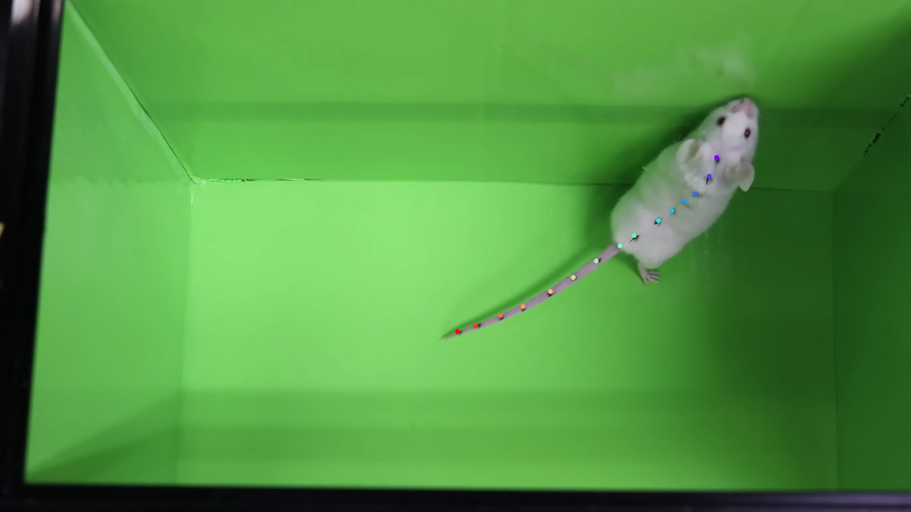
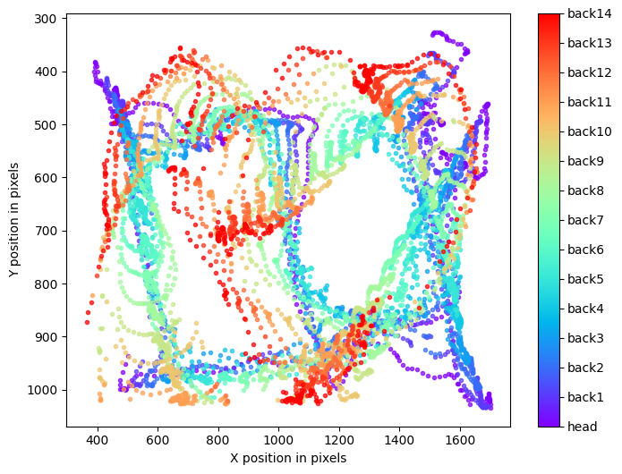
Results: Labeled spinal motions

Slide 7
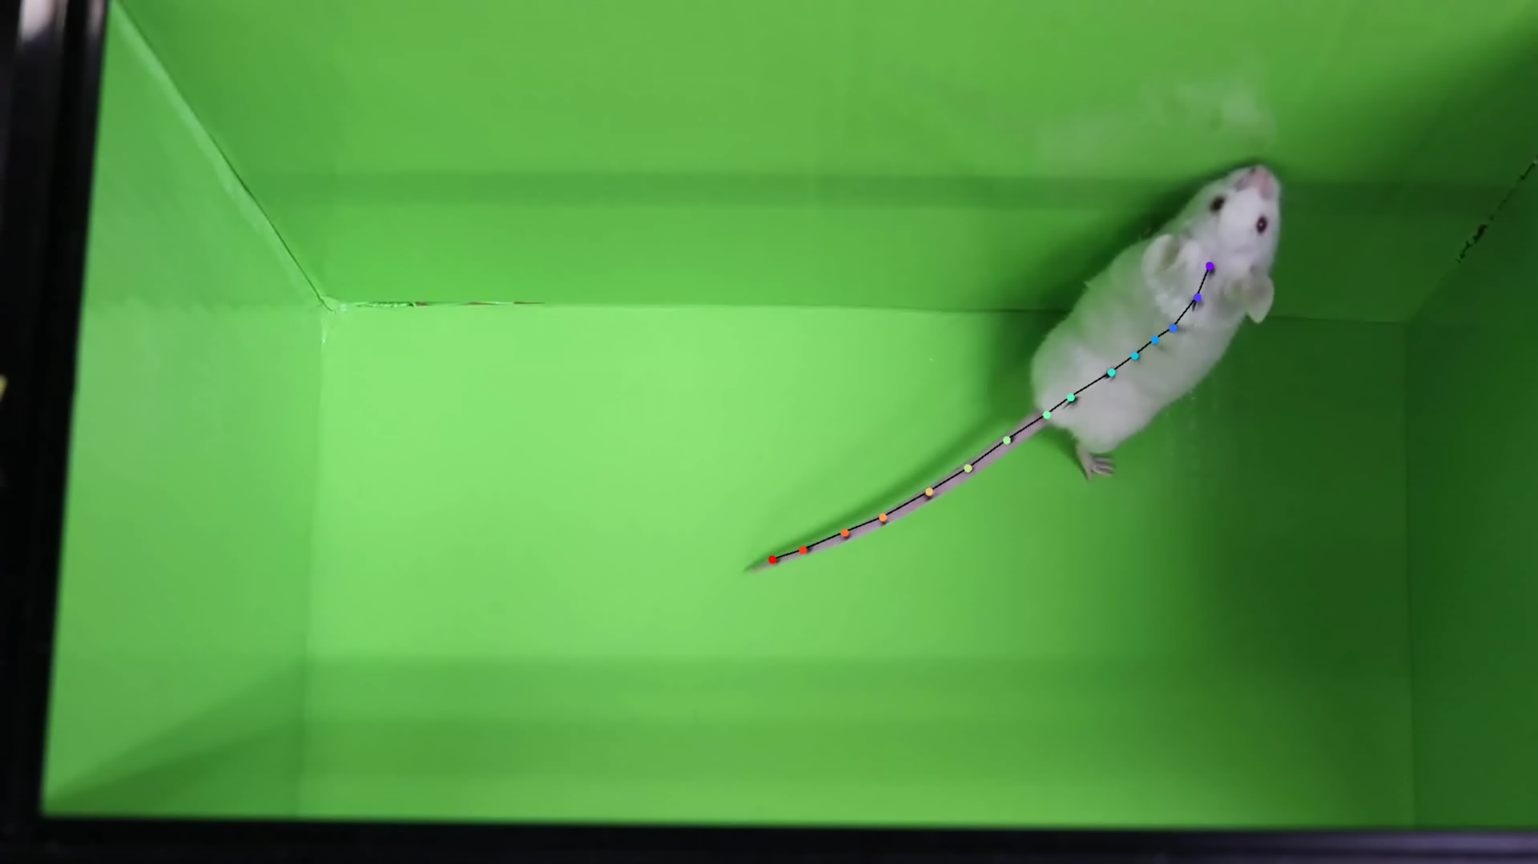
Results: Labeled spinal motions

Slide 8
Trajectory plot

Slide 9
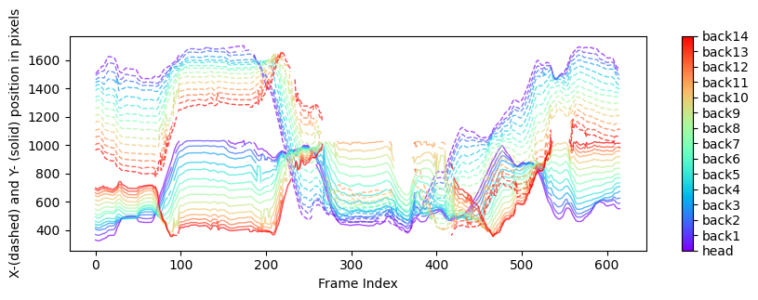
Trajectory plot

Slide 10
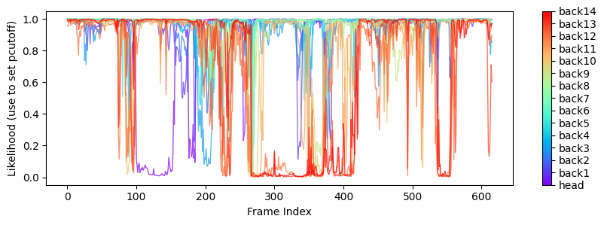
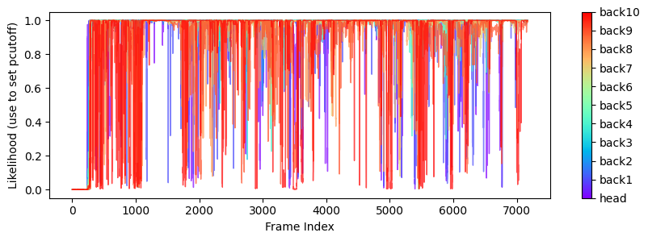
Likelihood plot
The new experients
The previous experients

Slide 11
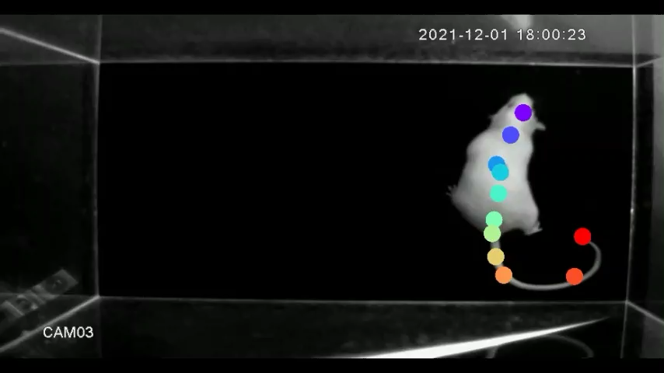
Labeled spinal motions

Slide 12
Summary
We setup a motion tracking system in a mouse facility in RIKEN BRC, Tsukuba.
We improved the accuracy of the motion tracking with:
15 markers on the spine;
A high-resolution camera (Canon EOS80D) with a reliable lens (EF-S18-55mm);
the green background to reduce visual noises.
We used color images for the motion tracking.
Proposals:
It may be possible to generate a general pattern of the spinal motions based on the obtained data.
A 3D motion tracking is worth to try (?)
By using hairless mutant mice, we may be able to remove hair-related artifacts.

